Slide 1
Introduction to Object Oriented Programming

Slide 2
3 Key Features
Encapsulation
Inheritance
Polymorphism

Slide 3
Encapsulation

Slide 4
Classes
A class defines a set of variables (attributes or data members) that can be associated with the methods which act on an object with the object itself.
data member
methods

Slide 5
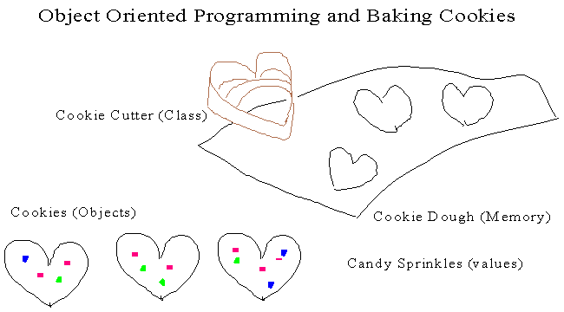
Classes
The following diagram explains the relationship between class and object.

Slide 6
Classes and Objects
s1:String
"Programming"
String (class)
s2:String
"Java"
s3:String
"example"
The String class can be used to define as many String objects as you like.
Its reusability is very high.
The String class is provided for us by the Java standard class library.
But we can also write our own classes that define specific objects that we need

Slide 7
Example
class TestStringClass {
public static void main(String s[]) {
String s1 = new String("Programming");
String s2 = new String("Java");
String s3 = new String("example");
System.out.println(s1.toUpperCase());
System.out.println(s2.toUpperCase());
System.out.println(s3.toUpperCase());
}
}
In this example, String is class. s1, s2 and s3 are the objects (or references to objects, precisely speaking). Each of them has different state but same behavior.

Slide 8
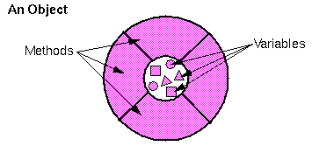
Encapsulation
emp1
num : 0
getNum
setNum
As you can see from the above diagram, an object's variables make up the centre or nucleus of the object. Methods surround and hide the object's nucleus from other objects in the program.
This is called encapsulation.

Slide 9
Encapsulation
Member access modifiers
Control access to class’ instance variables and methods
public
Variables and methods accessible to other classes
private
Variables and methods not accessible to other classes
Can be accessed via
Accessor method (“get” method)
Allow clients to read private data
Mutator method (“set” method)
Allow clients to modify private data

Slide 10
Example
public class Employee1 {
private String name;
private int salary;
public void setName(String name) {
this.name = name;
}
public void setSalary(int salary) {
this.salary = salary;
}
public String getName() {
return name;
}
public int getSalary() {
return salary;
}
}

Slide 11
public class TestEmployee1 {
public static void main(String[] args) {
Employee1 emp1 = new Employee1();
emp1.setName("Chan Tai Man");
emp1.setSalary(12000);
System.out.println("Employee 1: name=" + emp1.getName() + " salary="
+ emp1.getSalary());
}
}

Slide 12
Constructors
When user creates a new instance (a new object) of a class using the new keyword, a constructor for that class is called. It is used to initialize the instance variables (fields) of an object.
Same name as class
No return type (don’t declare void), NO return statement
Cannot be called directly (use this)
Only called when instantiating object of that class
If no constructor is defined by the programmer, a default "do-nothing" constructor is created for you.
If the class has defined a constructor (with or without parameters), Java will not provide a default constructor anymore.
Overloaded constructors may be defined.

Slide 13
Constructor Example - Employee
Constructor
public class Employee {
private int num;
public Employee(int newNum) {
num = newNum; // call setNum() is better, why?
}
public int getNum() {
return num;
}
public void setNum(int newNum) {
num = newNum;
}
}
public class PrintEmployee {
public static void main(String[] args) {
Employee emp;
emp = new Employee(71623);
System.out.println(emp.getNum());
}
}
>java PrintEmployee
71623

Slide 14
Inheritance

Slide 15
Inheritance
What is inheritance (繼承)?
Object-oriented systems allow classes to be defined in terms of other classes.
Classes can inherit variables and methods (operations) from other classes. The inheriting class can then add extra attributes and/or methods of its own.

Slide 16
Purpose of Inheritance
Extend the functionality of an existing class.
Share the commonality between two or more classes .
VTC_Student
IVE_Student
DVE_Student
TopUp_Student

Slide 17
Example
public class BankAccount {
private double balance;
public double getBalance();
// other member functions
}
public class ChequeAccount extends BankAccount {
public void WriteCheque (double amount) {
//...
}
// other member functions
}
ChequeAccount inherits BankAccount
In the above example, we can say that ChequeAccount is a subclass (or derived class or child class) of BankAccount and BankAccount is called a superclass (or base class or parent class).

Slide 18
Java General Syntax
superclass
subclass
class YYYY extends XXXX {
......
}
Java does not support multiple inheritance, that is a subclass CANNOT inherit from more than one superclass.
X
class PT_Stduent extends Student, Worker {
Inheritance is between classes, NOT between objects.

Slide 19
public class VideoTape {
String title; // name of the item
int length; // number of minutes
boolean avail; // is the tape in the store?
public VideoTape( String title, int length ) {
this.title = title; this.length = length; avail = true;
}
public void show() {
System.out.println( title + ", " + length
+ " min. available:" + avail );
}
}
public class Movie extends VideoTape {
String director; // name of the director
String rating; // G, PG, R, or X
// constructor
public Movie( String title, int length, String dir, String rating )
{
super(title, length); // use the super class' constructor
director = dir;
this.rating = rating; // initialize what's new to Movie
}
}

Slide 20
The statement super(title, length) calls the super class constructor to initialize some of the data.
The super() call must be the first statement in a constructor.
The class Movie is a subclass of VideoTape. An object of type Movie has the following members in it:

Slide 21
class Person {
// ...
}
class Student extends Person {
// ...
}
public class TestSubRef {
public static void main(String s[]) {
Person superRef1 = new Person();
Student subRef1 = new Student();
Person superRef2 = new Student();
Student subRef2 = new Person();
}
}
X
D:\TestSubRef.java:16: incompatible types
found : Person
required: Student
Student subRef2 = new Person();
^
1 error

Slide 22
Polymorphism

Slide 23
Polymorphism
Polymorphism
Polymorphism means "having many forms".
Consider that a superclass reference can refer to subclass objects.
When the variable is used with "dot notation" variable.method() to invoke a method, which method is exactly run depends on which variable the object is currently refers to.

Slide 24
Example using Polymorphism
class Circle extends Shape {
double radius;
public Circle(double radius) {
this.radius = radius;
}
public double area() {
return Math.PI*radius*radius;
}
}
public class TestShape4 {
public static void main(String[] args) {
Shape s = new Square(12.5);
System.out.println("The area of s is " + s.area());
s = new Circle(5);
System.out.println("The area of s is " + s.area());
}
}
Output
The area of s is 156.25
The area of s is 78.539816339744
s.area() calls the correct method
Shape s can refer to a Square or a Circle.

Slide 25
Comparison
Abstract | Interface
Use extends | Use implements
Can only inherit once | Can inherit lots of interfaces by class
Must be superclass | Can identify as the special case of abstract class
Can define attribute without limitation | Can only define attribute with static final
Common feature:
Cannot instantiate directly
It is necessary to implement the method

Slide 26
abstract Class Syntax
abstract Class
abstract Method
public abstract class Shape {
String name;
public abstract double area();
public String name() {
return name;
}
//other stuff
}
An abstract class CANNOT be instantiated.

Slide 27
Error syntax: an abstract Class
abstract class Shape {
String name;
abstract public double area();
public String name() {
return name;
}
//other stuff
}
public class TestShape {
public static void main(String[] args) {
Shape s = new Shape();
}
}
>javac TestShape.java
TestShape.java:10: Shape is abstract; cannot be instantiated
Shape s = new Shape();
^
1 error

Slide 28
abstract Class (with one or more abstract method(s) )
class Shape {
String name;
abstract public double area();
public String name() { return name; }
//other stuff
}
public class TestShape2 {
public static void main(String[] args) {
Shape s = new Shape();
}
}
>javac TestShape2.java
TestShape2.java:1: Shape should be declared abstract; it does not define area() in Shape
class Shape {
^
1 error

Slide 29
Interface
Java subclass CANNOT have more than one superclass, multiple inheritance is NOT supported.
Thus, Java applies interface to enable multiple "inheritance" concept.
An interface is a collection of abstract methods.
all methods are implicitly public and abstract
all data members are implicitly final, public and static

Slide 30
Interface example – Recordable
public class TV {
...
}
public interface Recordable {
public void Record();
public void Play();
}
public class TV_VCR extends TV implements Recordable {
public void Record() {
...
}
public void Play() {
...
}
//......
}

